Slide 1
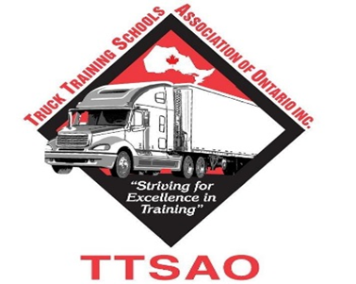
MELT Mandatory Entry Level training
“Striving For Success In Training”

Slide 2
Today’s Agenda
How Melt got it’s start
Where we were
Where are we now
How will it affect our industry
TTSAO Involvement

Slide 3
How it all began…
Toronto Star Exclusive Report
First contacted Mike McCarron, President & Founder of Left Lane Associates
Interviewed KRTS because we were leaders in the training industry and a member of TTSAO
Front page news with coverage by CTV
“There are these low-end, cut rate schools that are ripping off students and putting bad drivers on the road”
“Tractor trailers, which are at least 40 times heavier than the average passenger car, some of these drivers are not being tested on a major highway which is a big part of their job, I was stunned”
Mary Ormsby
Feature writer for the Toronto Star

Slide 4
Big-truck ‘licensing mills’ put public at risk By KENYON WALLACE News reporter MARY ORMSBY Feature reporter Tues., Oct. 14, 2014
The Star found two dozen unregulated schools in the GTA that offer to teach students just enough to earn their AZ licence — required to operate a tractor-trailer with air brakes — and to clear new drivers with scant hours behind the wheel to operate a vehicle about 40 times heavier than a car.
In fact, the Star discovered there is no requirement for any tractor-trailer driving instruction. Candidates are not asked where they were trained — or if they were trained — before booking a provincial DriveTest exam.

Slide 5
Big-truck ‘licensing mills’ put public at risk By KENYON WALLACE News reporter MARY ORMSBY Feature reporter Tues., Oct. 14, 2014
Insurance studies show Canada requires an additional 375,000 new drivers over the next decade as the current generation — the average trucker age is 57 — begins to retire. The “fly-by-night” schools are not producing drivers who qualify for insurance from reputable companies, and therefore their graduates cannot get jobs.
https://www.thestar.com/news/gta/2014/10/14/bigtruck_licensing_mills_put_public_at_risk.html

Slide 6
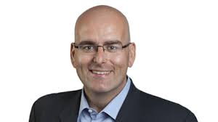
Where we were…
TTSAO held first round table with Minister Del Duca
Minister Steven Del Duca made the first announcement in the Fall of 2014
Consultations with industry members began in the Spring of 2015
" The safety of all users of Ontario's roads and highways is our top priority. The introduction of mandatory training in addition to knowledge and road tests is designed to ensure that commercial truck drivers are properly trained before they are tested." - Steven Del Duca Minister of Transportation

Slide 7
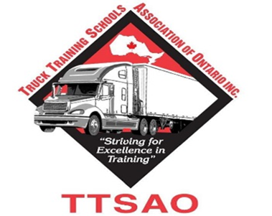
Where we were…
Over 20 consultations meetings were held between Spring 2015 & 2016
The consultations included a variety of people from all industry sectors including private carriers and “for-hire” carriers, schools, insurance etc.

Slide 8
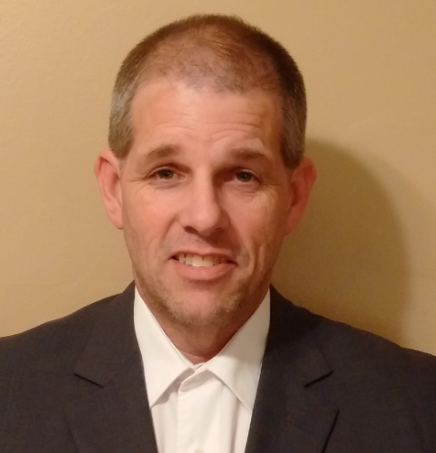
Where we are now
Press conference to announce MELT standard was held on June 28, 2016
As of July 1st 2017, no one will be allowed to attempt their Class A Road Test until they have completed MELT training from an approved & Certified training facility
" Overall the mandatory entry-level training standard is a great win for the industry and will help to raise the profile of the job of the professional driver in our industry. The standard will also go a long way in removing the unqualified licensing mill training schools from our industry." - Mike Millian President, Private Motor Truck Council of Canada

Slide 9
What will be the new standard
MELT standard will require 103.5 hours – 36.5 in class, 17 pre-trip, 18 in truck(off road), 32 one on one in truck
 | Classroom | In-Yard (Around the Vehicle) | In-Cab (Behind the Wheel) | Total
Class A | 36.50 | 17 | 50 (32 on-road, 18 off-road) | 103.50
Airbrake |  |  |  | 12
In – Class = Classroom
In- Yard = Vehicle is not moving; e.g. vehicle inspection
In – Cab = Driver is BTW; e.g. backing, coupling/uncoupling, driving along

Slide 10
What will be the new standard
On-road test will ensure new drivers can safely complete four right turns, four left turns, four intersections (two stop and two through), two lane changes, one driving along, one expressway section, two curves (one left and one right), and one emergency roadside stop/start
Drivers will also have to complete either an offset backing (left or right) or an alley dock 90-degree backing
The written test will now comprise of 30 questions rather than 20, randomly selected from a set of 120 new competency-based questions

Slide 11
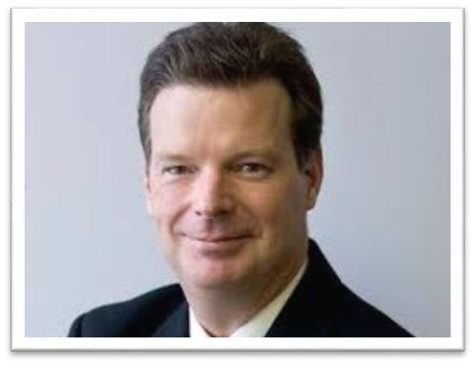
How will it affect our industry
Transitioning from assembly line “licensing mills” to more in-depth, rigorous commercial truck driver training
Consistent provincial training standard
Qualified and trained commercial Class A drivers
Elimination of inadequate training
Most importantly… SAFER ROADS!
" By being the first jurisdiction in North America to introduce mandatory entry-level training for commercial truck drivers, Ontario is leading the way in terms of further improving highway safety and helping the industry to ensure it has an adequate supply of consistently trained, quality new drivers in the future. This is a game-changer. " - David Bradley CEO, Ontario Trucking Association

Slide 12
TTSAO Involvement
TTSAO was involved in every consultation meeting with MOT, MAESD (formally MTCU)
Member of OTA Melt Stakeholder Group
Liaised with the major insurance providers for entry level and existing commercial drivers
Worked in harmony with PMTC to ensure mutual goals were met
" The Truck Training Schools Association of Ontario which represents the majority of Truck Driving Schools in Ontario, was very pleased to be invited and involved from the grass roots discussions of mandatory entry-level training. The new standard will help to produce higher quality commercial drivers and ultimately make our roads safer for everyone."
- Kim Richardson
TTSAO Chairman of the Board

Slide 13
Who is the TTSAO ?
The Truck Training Schools Association of Ontario represents the majority of professional truck driver training schools in Ontario. …. committed to providing the trucking industry with the highest quality driver training programs for entry-level individuals.
TTSAO board of directors includes representation from schools, insurance providers, private fleets and for-hire carriers.

Slide 14
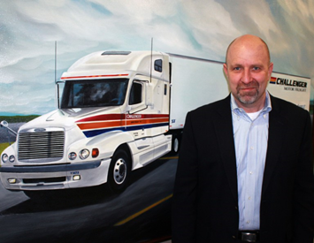
Who is the TTSAO Carrier Group?
TTSAO Carrier Group, a division of the TTSAO, provides the only forum for carriers to meet and have influence over training curriculum to help ensure their business needs are being met
The mandate of the TTSAO Carrier Group is to support the TTSAO in all efforts that will improve education and recruitment and retention for entry level and existing Professional Drivers
“The TTSAO Carrier Group is open to all carriers regardless of size or what you may haul and are invited to the first meeting. All you need to do is register and let us know that you will be attending.”
Geoff Topping
Senior Director, Human Resources

Slide 15
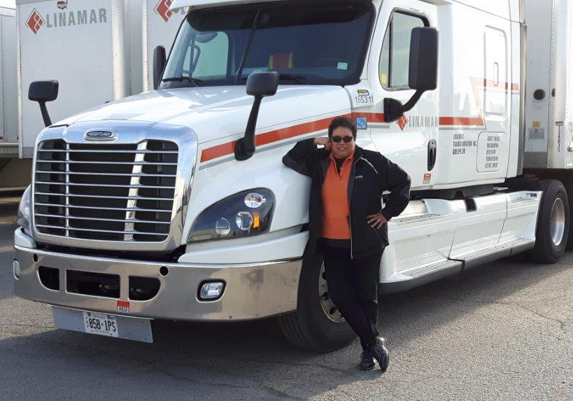
Who is the TTSAO Carrier Group?
The TTSAO Carrier Group works with the TTSAO Board of Directors and its membered schools to increase awareness and education in reference to the educational needs of all carriers both for hire and private
The carriers are the end users. The New Carrier Group ensures that carriers have the opportunity to be fully represented with in the TTSAO
“Linamar Transportation strives to remain at the forefront of industry developments in terms of safety for our employees and the motorists we share the roadways with every day.
The TTSAO Carrier Group provides us the forum we need to actively engage in current and emerging programs such as MELT.”
Brenda Moeser
Compliance Coordinator, Linamar Transportation

Slide 16
Who are the TTSAO Associate Members?
Associate members are comprised of various industry suppliers including employers, associations, insurance and other stakeholders
Northbridge Insurance was happy to be involved in the discussions and review of the new MELT Standard. Having the opportunity to work alongside industry representation, including our partners at the TTSAO, is a great start in helping the transportation industry produce higher quality drivers and make the roads safer for everyone involved.
Charlie Charalambous
Northbridge Insurance, Risk Services Training Team Leader
TTSAO Director of Communications and Public Relations

Slide 17
Mark your calendars because You won’t want to miss this!

Slide 18
For more information about the TTSAO and learn how to become a member contact…

